Slide 1
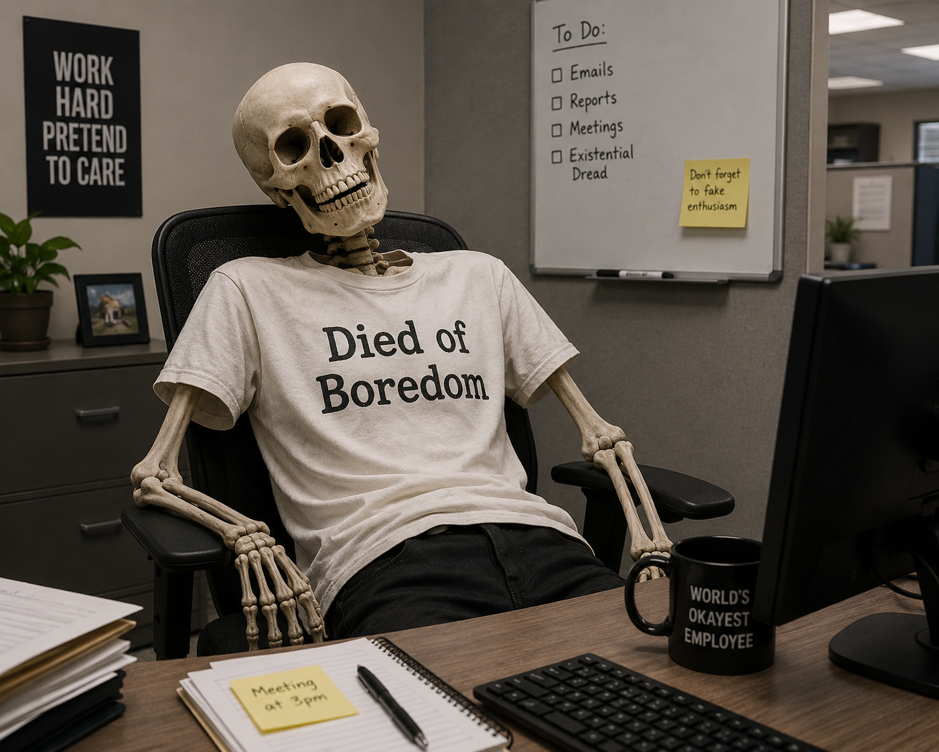
Super Fun
Compliance
Awareness
Training!

Slide 2
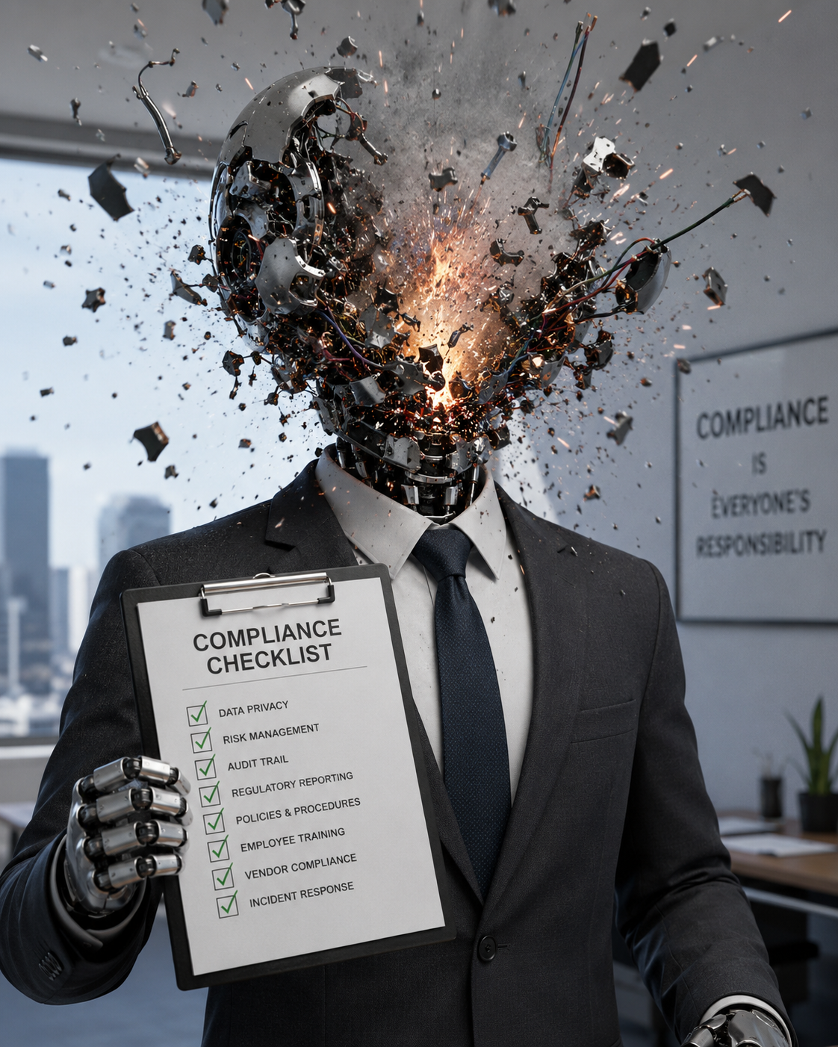
What is compliance?
“Great. Another checklist.”
- Bob the Robot shortly before his head exploded.
Compliance isn’t complicated or boring.
No, really!
A wise man once said “The fastest cars have the best brakes.”
Compliance isn’t meant to rain on your parade. It wants to get you where you’re going safe and sound while minimizing risk.
Compliance means following the rules.
Whether those are laws, industry standards, and/or internal company policies, compliance makes sure that you or your organization operate legally, safely, and ethically to avoid penalties and protect your reputation.

Slide 3
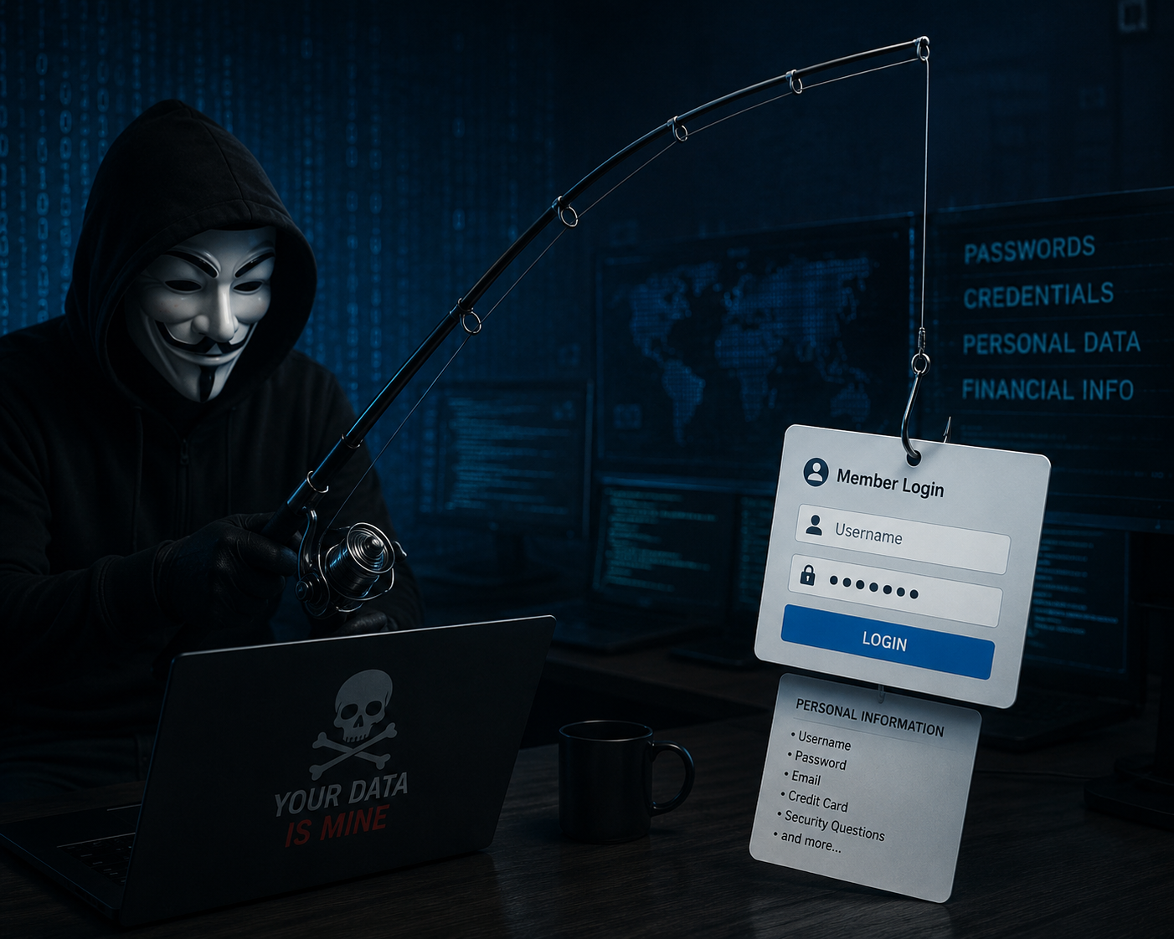
Phishing Basics

Slide 4
Phishing
What it isn’t:
Where Elmer Fudd goes to catch seafood.
Leaving it all behind to follow the band Phish on tour.
What it is:
Phishing is a type of cyberattack where scammers deceive people into revealing sensitive information like passwords, credit card numbers, or social security details by impersonating a trusted source.
In 2026, these attacks have become increasingly sophisticated, often using AI-generated content and QR codes to bypass traditional security filters.

Slide 5
How to Protect Yourself
Use Multi-Factor Authentication (MFA): Enable app-based MFA (like Google Authenticator) or hardware keys (like YubiKey) on all critical accounts. Avoid SMS-based codes when possible, as they’re vulnerable to SIM swapping.
Verify Independently: If you receive a suspicious request from an organization, DO NOT use the contact info provided in the message! Instead, visit their official website directly or call a verified number from a past statement.
Think Before You Click: Hover your mouse over links to see the true destination URL. If a link takes you to a login page you didn't expect, close the tab and navigate to the site yourself.
Use a Password Manager: Tools like Bitwarden or 1Password can generate and store unique, 20+ character passwords for every site, preventing "credential stuffing" if one site is breached.
Keep Software Updated: Regularly update your operating system and security software to protect against the latest threats and vulnerabilities.

Slide 6

Password
Security

Slide 7






123456
Password1
Mynamewithnospaces
Please.
Don’t.
Use.
These.
Passwords!
Password security is the practice of creating and managing credentials to prevent unauthorized access to your digital accounts.
It’s important because passwords are the primary "keys" to your personal identity, financial information, and private communications.
A single weak password can allow a hacker to compromise your entire digital life through credential stuffing or identity theft.

Slide 8
How to Create a Secure Password
Complexity: Use a mix of uppercase and lowercase letters, numbers, and symbols. A strong password should be at least 12 to 16 characters long.
Uniqueness: Never reuse passwords across different sites. If one site is breached, hackers will immediately try those same credentials on banking, email, and social media platforms.
Randomness: Avoid predictable patterns like "123456," common words ("password"), or personal info like birthdays or pet names.
Password Managers: Use a tool like Bitwarden or 1Password to generate and store complex, unique passwords for every account so you only have to remember one master key.
Multi-Factor Authentication (MFA): Always enable MFA where available. This adds a second layer of defense, such as a code from an app or a physical security key, making it much harder for attackers to gain access even if they steal your password.

Slide 9
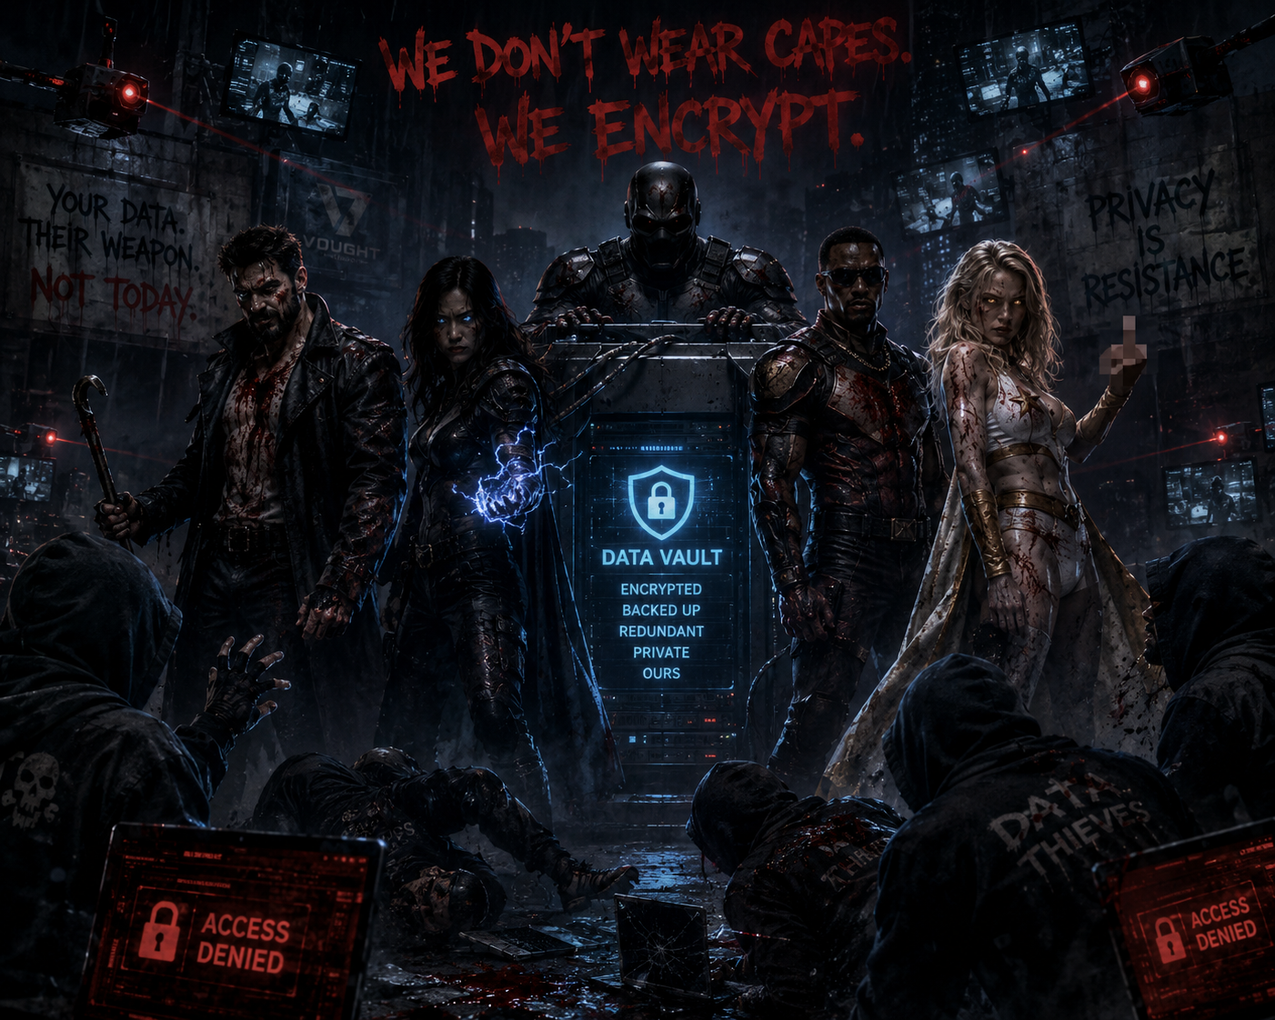
Data Collection

Slide 10
Data protection is the process of safeguarding sensitive information from unauthorized access, loss, or corruption to ensure its privacy and availability. In 2026, data protection has evolved to address sophisticated AI-driven threats and a complex landscape of global regulations.
Why Data is Collected
Service Personalization: To remember user preferences, like shopping carts or local weather, and provide tailored content.
Marketing & Advertising: To build consumer profiles for targeted ads based on demographics, purchase history, and browsing behavior.
Business Analytics: To improve user experience by analyzing how people interact with websites and apps.
Operational Necessity: For essential functions like processing payroll, managing student records, or fulfilling legal obligations.
Data Protection Basics
Effective data protection centers on three fundamental pillars known as the CIA Triad:
Confidentiality: Ensuring data is accessible only to authorized users.
Integrity: Maintaining the accuracy and trustworthiness of information by preventing unauthorized changes.
Availability: Ensuring data remains accessible for business needs even after a system failure or attack. [1, 2, 11]

Slide 11
How to Protect Your Data
Use Privacy-Focused Tools: Switch to browsers like Brave or Firefox and use search engines that don't track you.
Enable Universal Opt-Outs: Use tools like Global Privacy Control (GPC) to automatically signal your privacy preferences to websites.
Audit App Permissions: Regularly review settings on your mobile device to revoke "Always" location access or unnecessary microphone/camera permissions for utility apps.
Practice Identity Compartmentalization: Use email aliasing and virtual phone numbers to prevent different accounts from being linked into a single trackable profile.
Secure Your Hardware: Enable full-disk encryption on your computer and use a password manager with multi-factor authentication (MFA) to lock down access.

Slide 12
TL; DR Compliance Training Summary
Password security is the practice of creating and managing credentials to prevent unauthorized access to your digital accounts.
Create a secure password by making it using a mix of uppercase and lowercase letters, numbers, and symbols, never reusing passwords across different sites, using a password manager (like Bitwarden or 1Password), and Multi-Factor Authentication (MFA).
Data protection safeguards your sensitive information from unauthorized access, loss, or corruption to ensure its privacy and availability. In 2026, data protection has evolved to address sophisticated AI-driven threats and a complex landscape of global regulations.
Protect Your Data by: Using Privacy-Focused Tools, Enabling Universal Opt-Outs, Auditing App Permissions, Practicing Identity Compartmentalization, Securing Your Hardware!
Compliance means following the rules.
Whether those are laws, industry standards, and internal company policies, compliance makes sure that you or your organization operate legally, safely, and ethically to avoid penalties and protect your reputation.
Phishing is a type of cyberattack where scammers deceive people into revealing sensitive information like passwords, credit card numbers, or social security details by impersonating a trusted source.
Protect yourself by: Using Multi-Factor Authentication (MFA), Verifying Independently, Thinking Before You Click, Using a Password Manager, Keeping Software Updated!

Slide 13

STAY SECURE
AND

